Slide 1

Wave Properties Forecasting
DATAz - Digital Twin for the Azores Free Technological Zone
Bernardo Chagas, nº 103639

Slide 2
Table of contents
05
01
06
02
07
03
08
04
00
Introduction & Problem Definition
Results & Performance
Literature Review
Discussion
ERA5 Dataset & Data Preparation
Conclusion
Methodology & Approach
Next Steps
Architecture Design

Slide 3
Introduction & Problem Definition

Slide 4
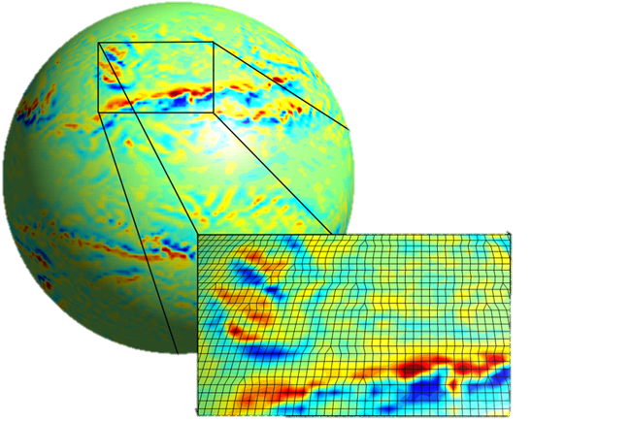
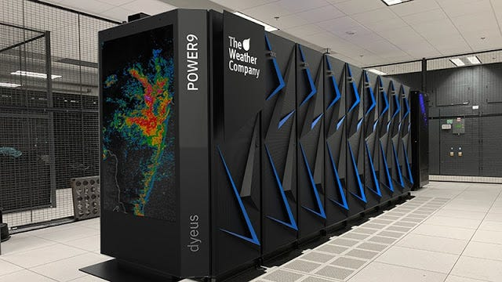
The Challenge
Weather Forecasting Complexity
Requires solving large-scale numerical models
High spatial and temporal resolution needed
Demands significant computational power
Energy-intensive processes
Dependent on supercomputing infrastructures
(1)
(2)
High-Resolution Numerical Model
IBM's Global High-Resolution Atmospheric Forecasting (GRAF)

Slide 5
Project Goals
Primary Objective
Enable evaluation of weather and oceanic scenarios in a virtual environment that does not rely solely on high-performance computing systems.
Practical Application
Allow the study of what-if scenarios, providing a powerful tool for decision-makers.
Approach
Preliminary study using ERA5 hourly time-series data from the Copernicus Climate Data Store (CDS), focusing on the Azores Free Technological Zone.

Slide 6
Literature Review
Main Keynotes:
SWAN simulation relies on solving Action balance equation
The state of the sea is computed from wind-wave interaction
Models used:
Convolutional LSTM
Physical Informed Neural Networks (PINNs)
Spatial - Temporal Transformer Networks (STTN)

Slide 7

Paper Prepared for IEEE WCCI 2026 Submission

Slide 8
ERA5 Dataset
Characteristics
Hourly atmospheric and oceanographic records
Spatial resolution: 0.25° in latitude and longitude
Data assimilation from historical observations (weather stations, ships, buoys, satellites)
Numerical models constrained by real observations
Result
Coherent, gridded information system providing consistent estimates of atmospheric state over time.

Slide 9
ERA5 Dataset: Variables
Variable | Description | Units
u10 | U-component of 10 m wind | m/s
v10 | V-component of 10 m wind | m/s
d2m | 2 m dew point temperature | K
t2m | 2 m temperature | K
msl | Mean sea level pressure | Pa
sst | Sea surface temperature | K
skt | Skin temperature | K
Variable | Description | Units
sp | Surface pressure | Pa
ssrd | Surface solar radiation downwards | J/m²
strd | Surface thermal radiation downwards | J/m²
tp | Total precipitation | m
mwd | Mean wave direction | degrees
mwp | Mean wave period | s
swh | Significant wave height | m

Slide 10
ERA5 Dataset: Data Preparation Process
Download Process
Python notebook "0. Download Dataset.ipynb" developed
API configuration for data retrieval
Specified space and time intervals
Files downloaded in ZIP format
Two different files per spatial point
Processing:
Files extracted and merged into single file per spatial point
Data stored in "dataset_train" and "dataset_test" folders
"1. Preprocessing.ipynb" notebook compiled datasets into "combined.nc"
Visualization procedures developed

Slide 11
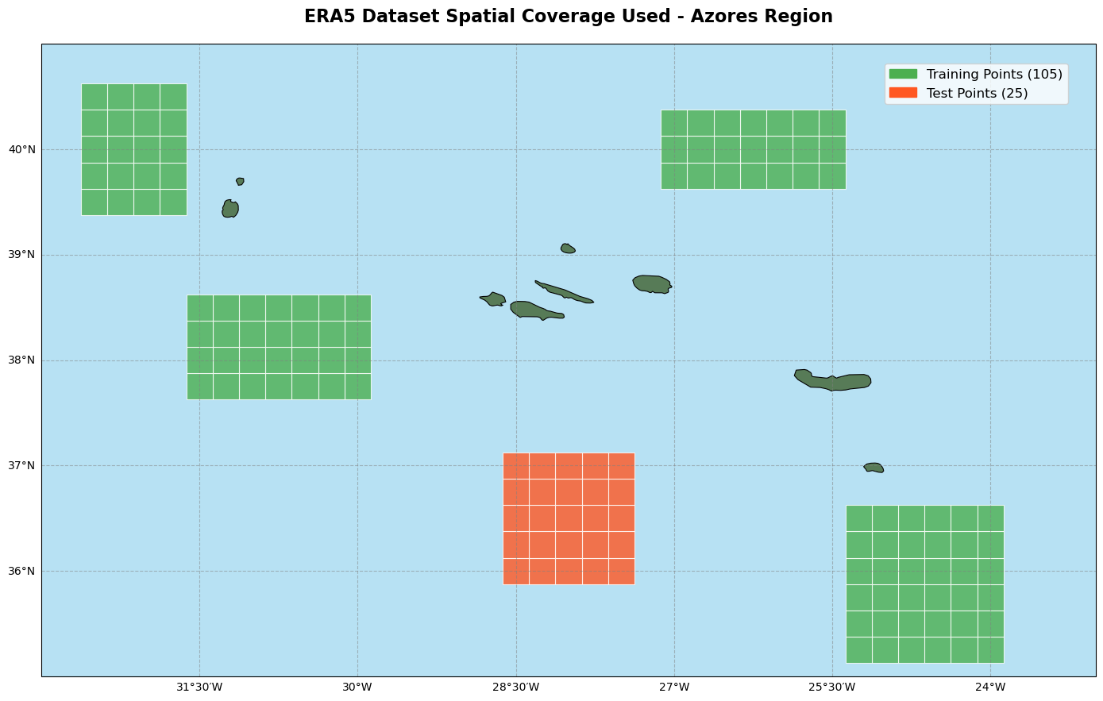
ERA5 Dataset: Data Preparation Process

Slide 12
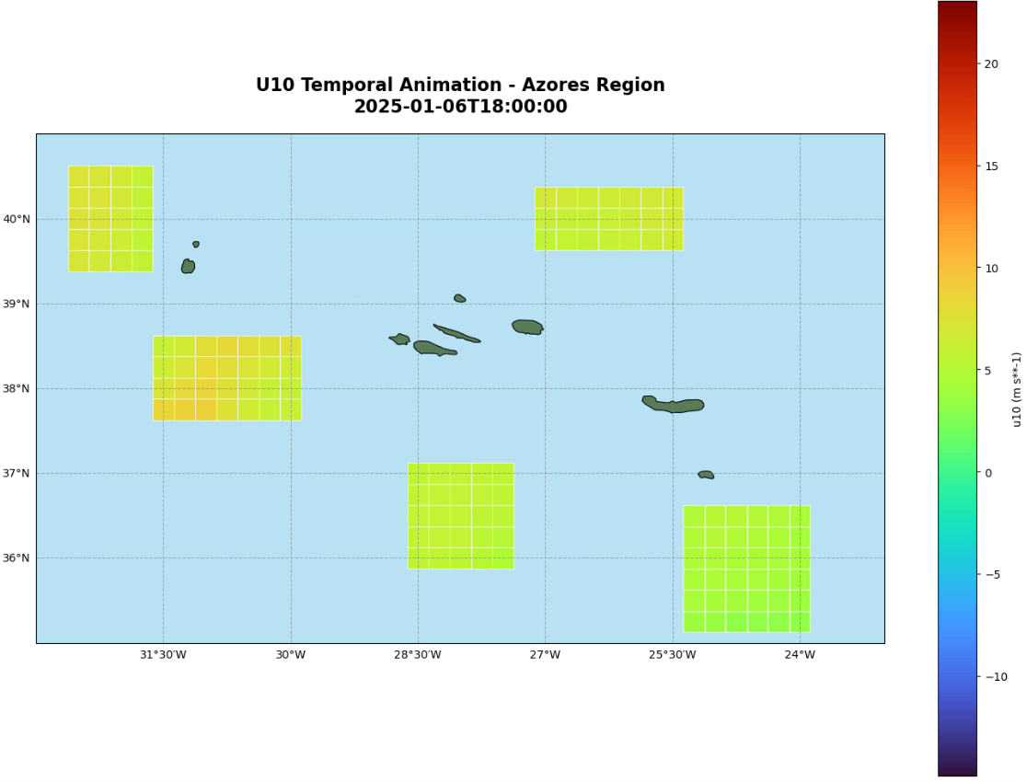

Slide 13
Methodology & Approach: Region Selection
Geographical Boundaries
Latitude: 35° to 41° North
Longitude: 23° to 33° West
Coverage Adequately covers the Azores Archipelago and surrounding oceanic area
Time Period January 1st, 2025 to October 3rd, 2025 Total: 6,624 registers per spatial point
Rationale Representative analysis of local dynamics
24 rows (latitude) * 41 columns (longitude) * 6624
= 6,5 millions of registers

Slide 14
Methodology & Approach: General Approach
Grid-Based Approach Incorporates information from neighboring points
Rationale Wave behavior is spatially correlated; evolution of a target point is influenced by surrounding environmental conditions.
Implementation
Central point + 8 adjacent neighbors
Wave properties predicted one hour ahead using data from all 9 points
1 | 2 | 3
4 | 5 | 6
7 | 8 | 9
(9 points) × (6 features) × (2 time steps) = 108 input features

Slide 15
Architecture Design

Slide 16
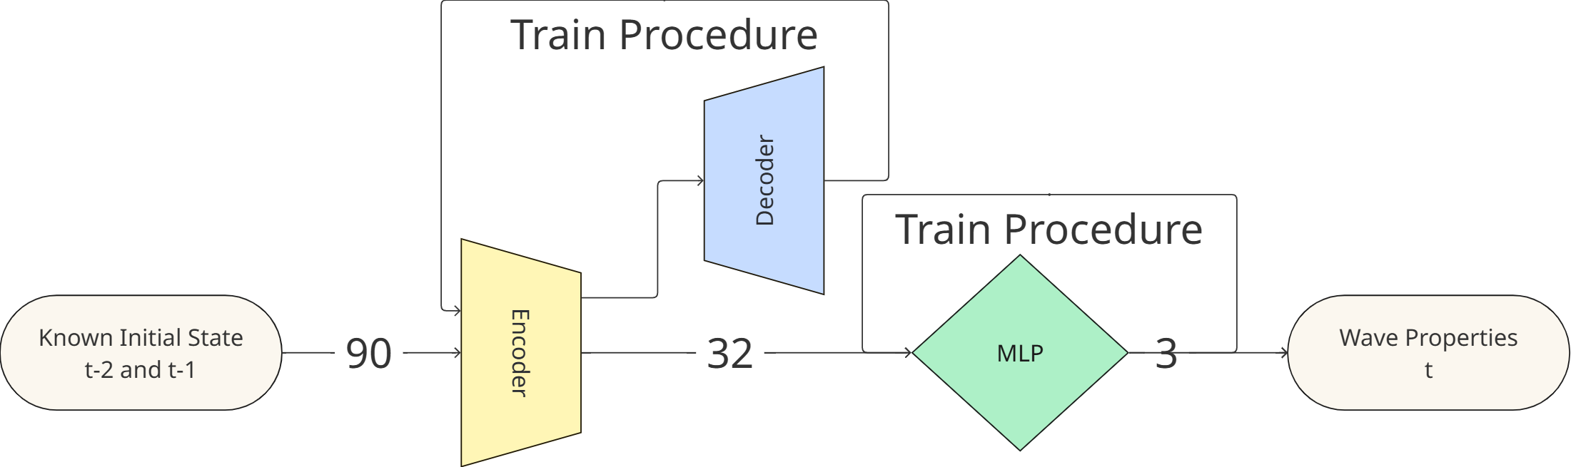
Architecture Design

Slide 17
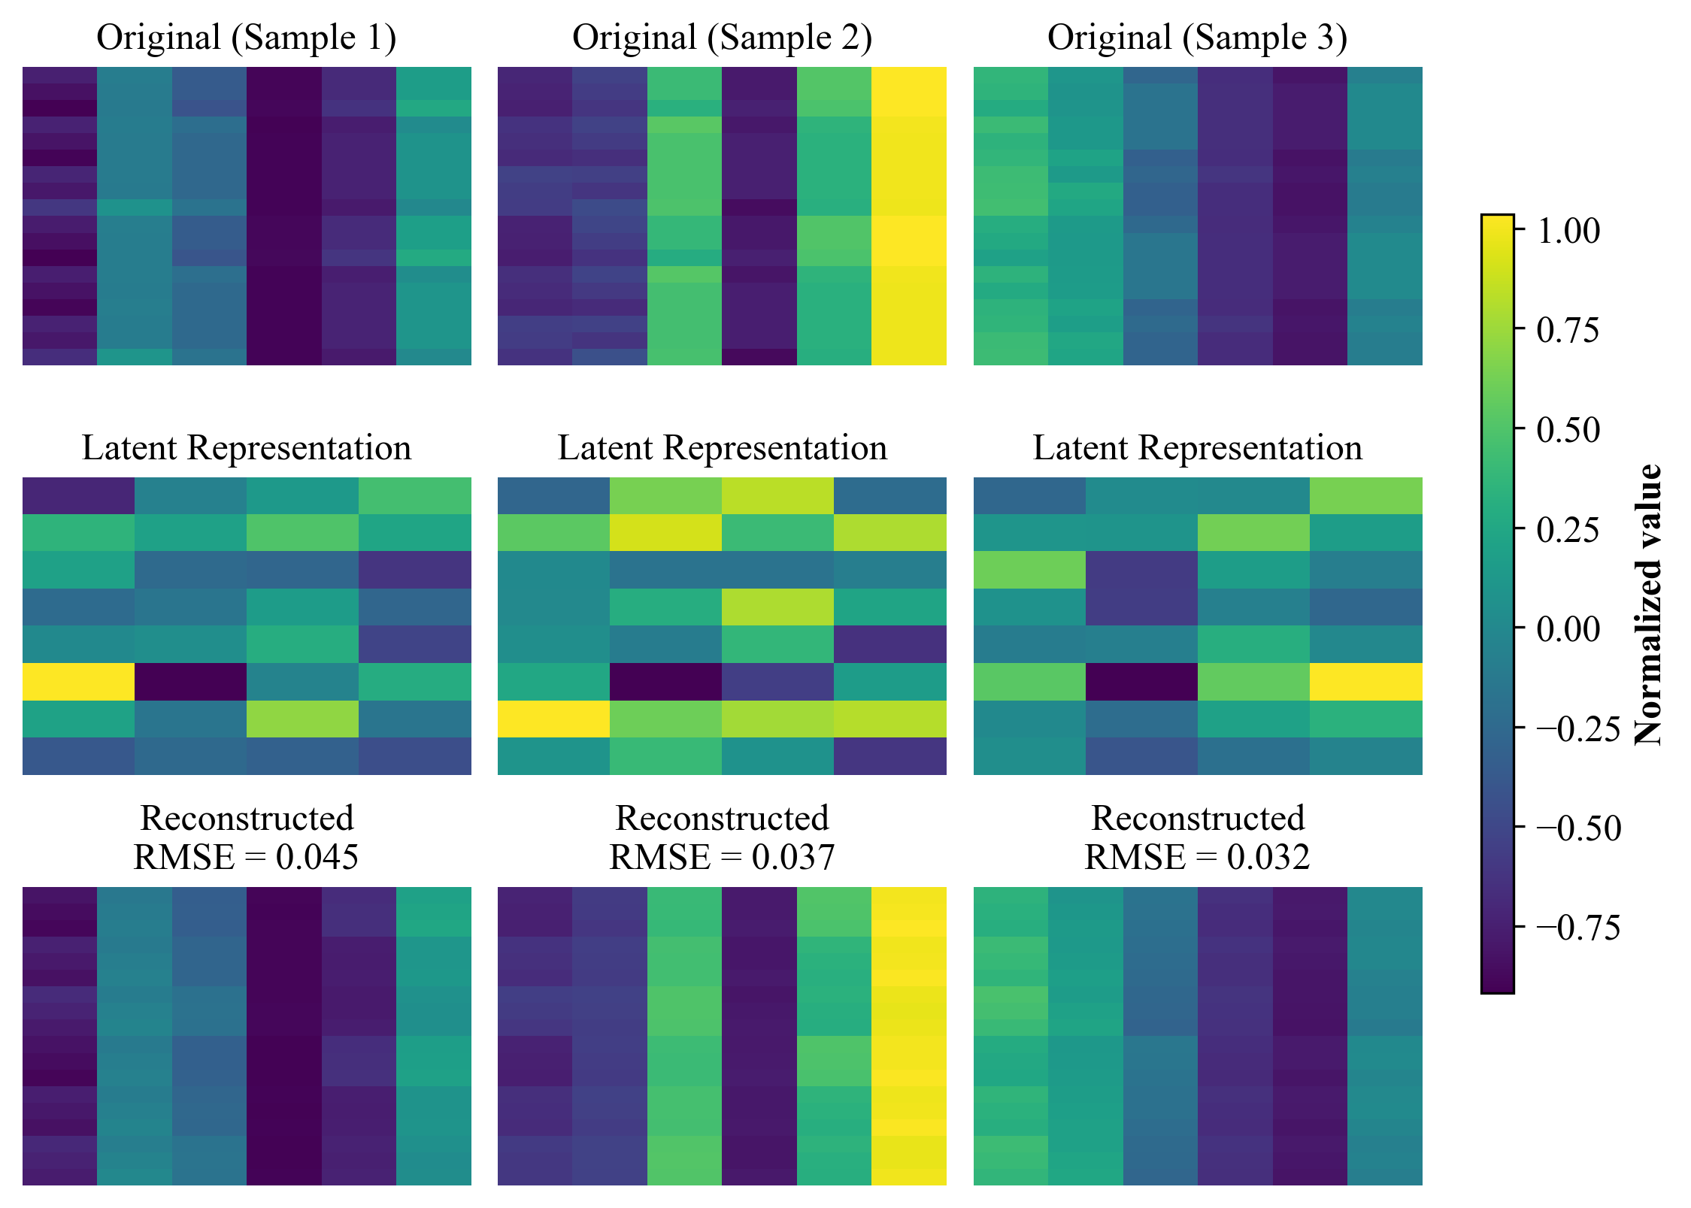
Architecture Design: Autoencoder
Design
Input: 108 dimensions
Latent space: 32 dimensions
Output: 108 dimensions
Reduction factor: ~3x
Test Set Performance
NRMSE = 0.112
(Standard scaler and autoencoder saved for consistency in next phase)

Slide 18
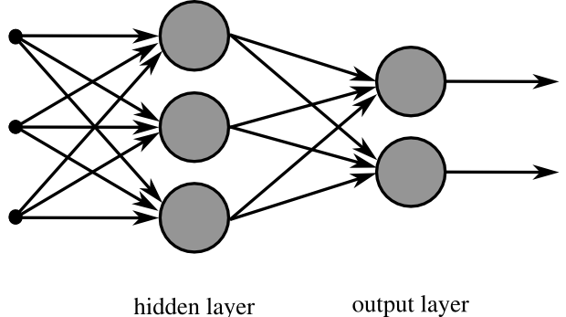
Architecture Design: MLP
(3)
Design
Input: 32 latent features (encoded by autoencoder)
Layer 1: 256 neurons (4× latent dimension)
Layer 2: 128 neurons (½ of previous layer)
Activation: ReLU (Rectified Linear Unit)
Regularization: Dropout layer to prevent overfitting
Output: 3 wave parameters (mwd, mwp, swh)
Hyperparameters/Choices:
Algorithm: Adam optimizer
Learning rate: 0.001
Loss function: Mean Squared Error (MSE)
Epochs: 393
Batch size: 64
Generic MLP representation

Slide 19
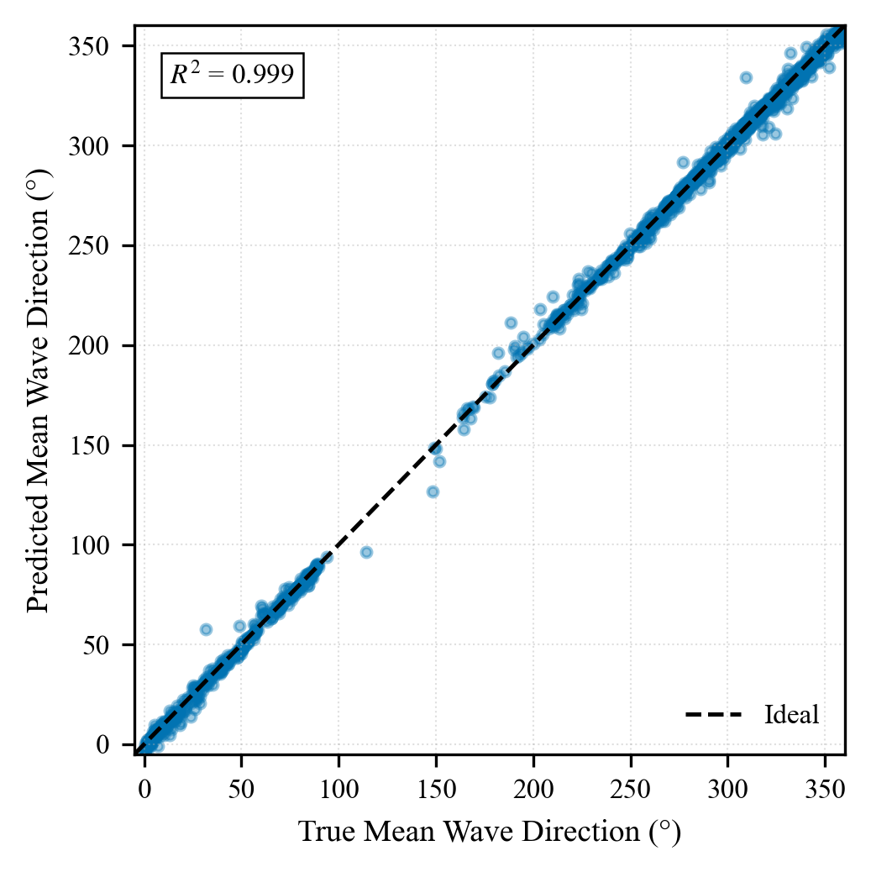
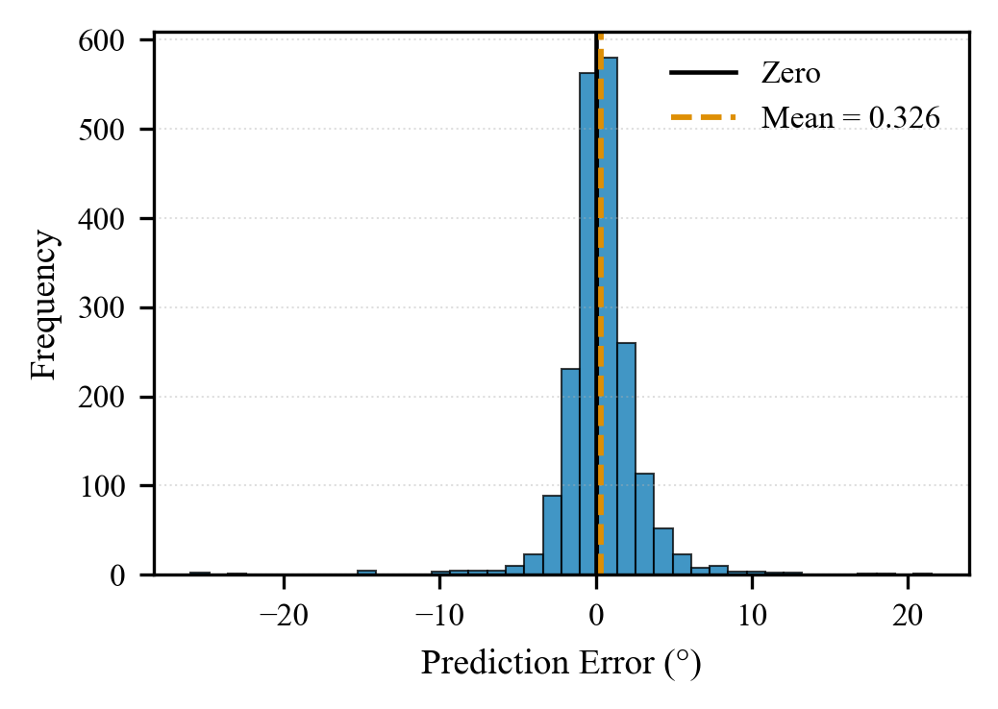
Results and Performance: mwd

Slide 20
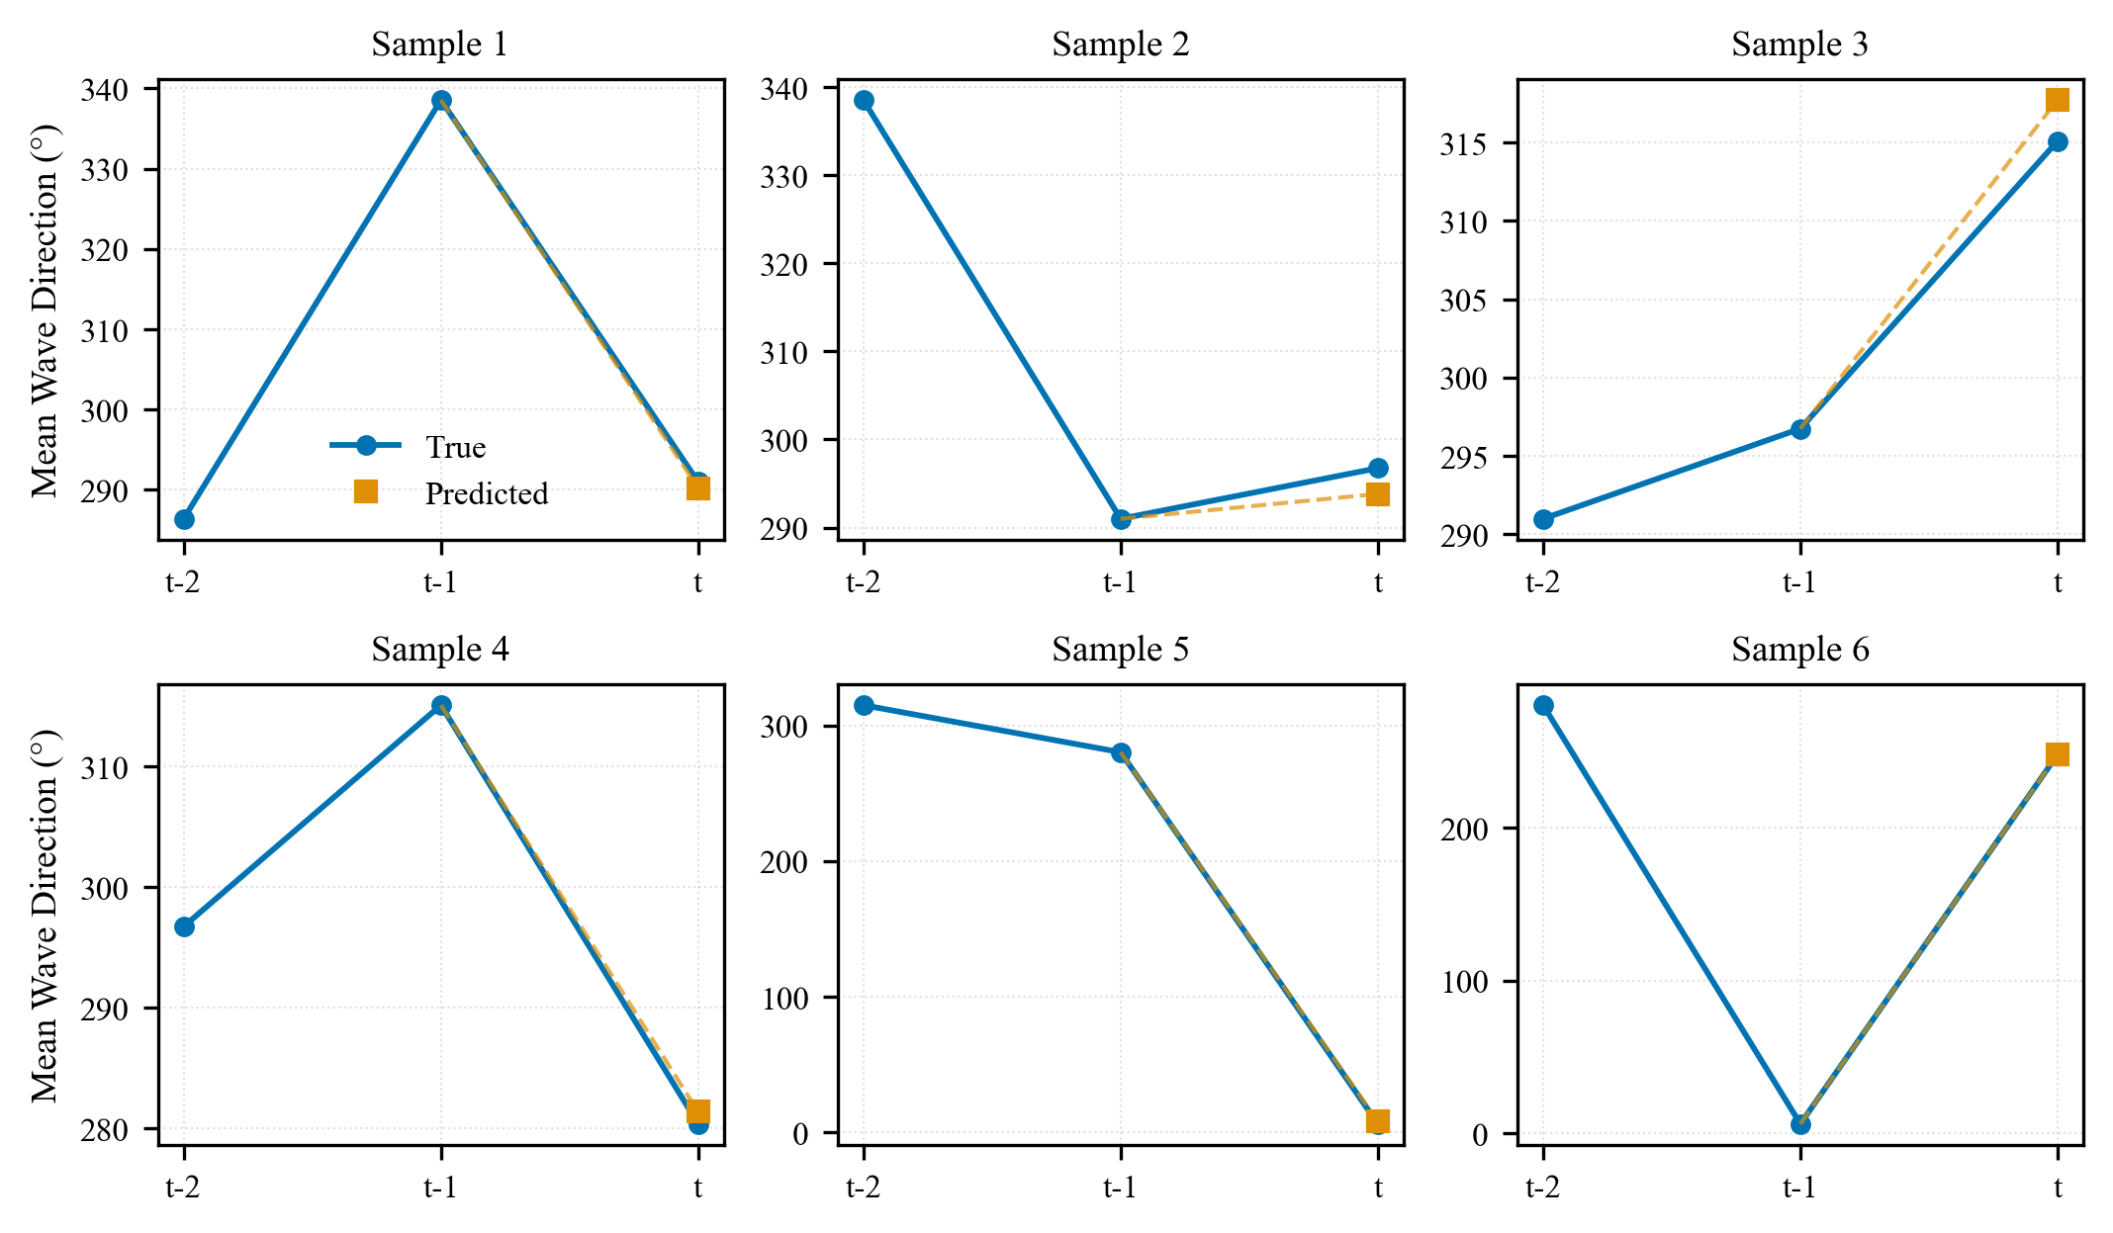
Results and Performance: mwd

Slide 21
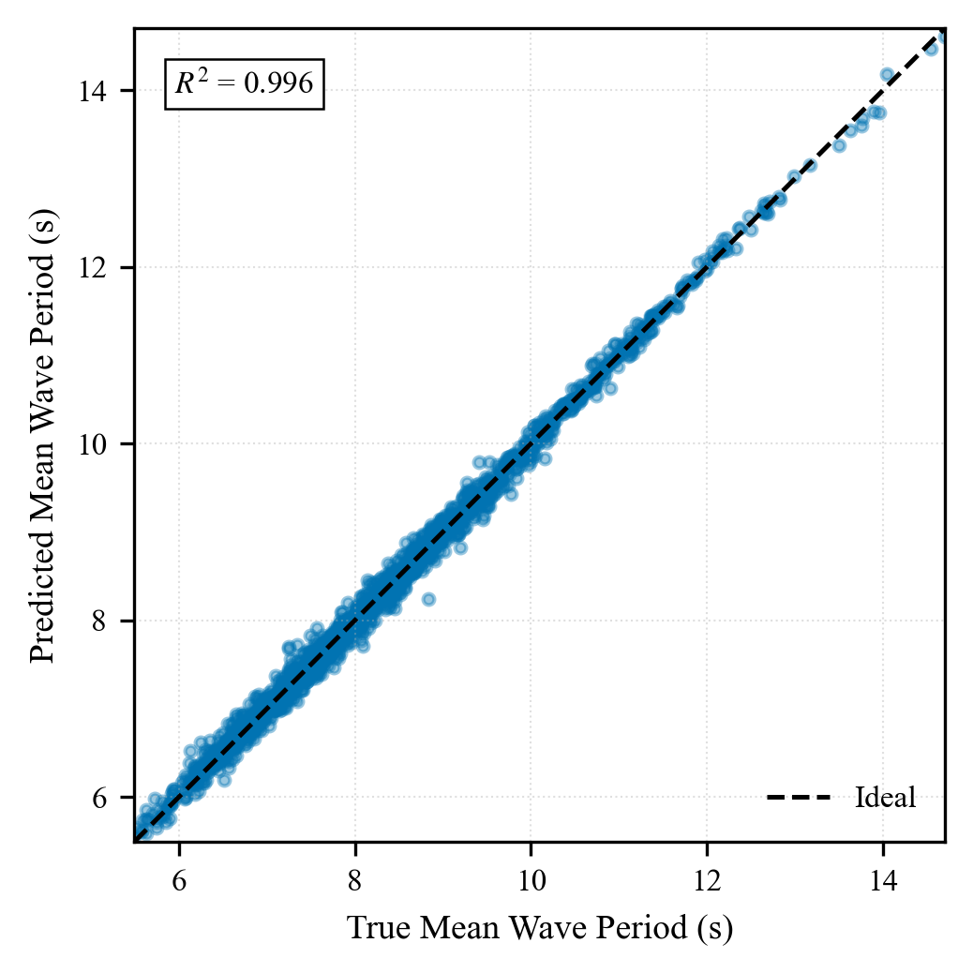
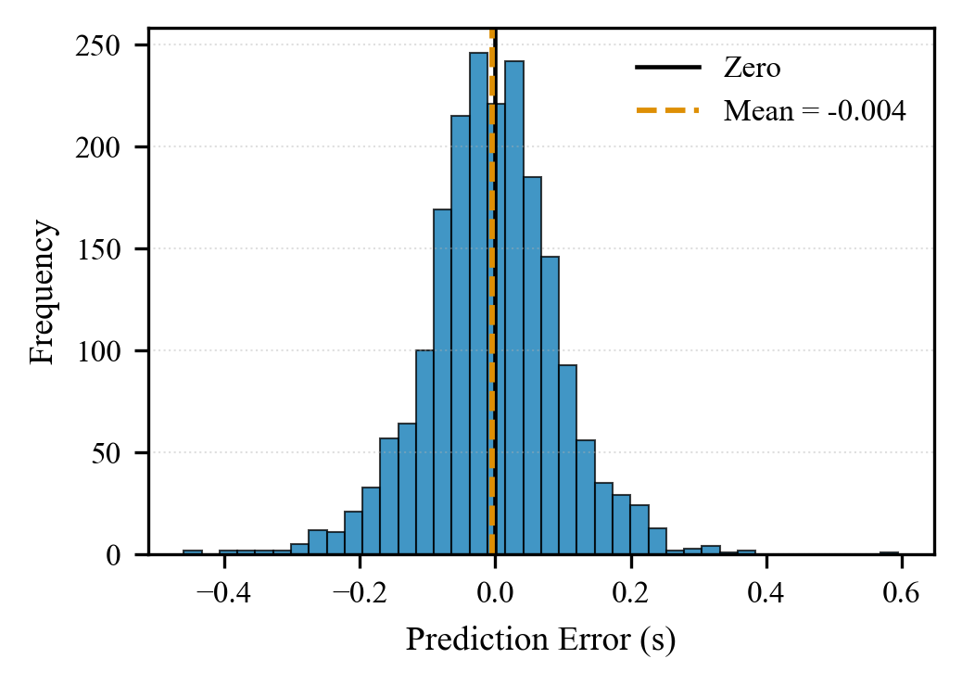
Results and Performance: mwp

Slide 22
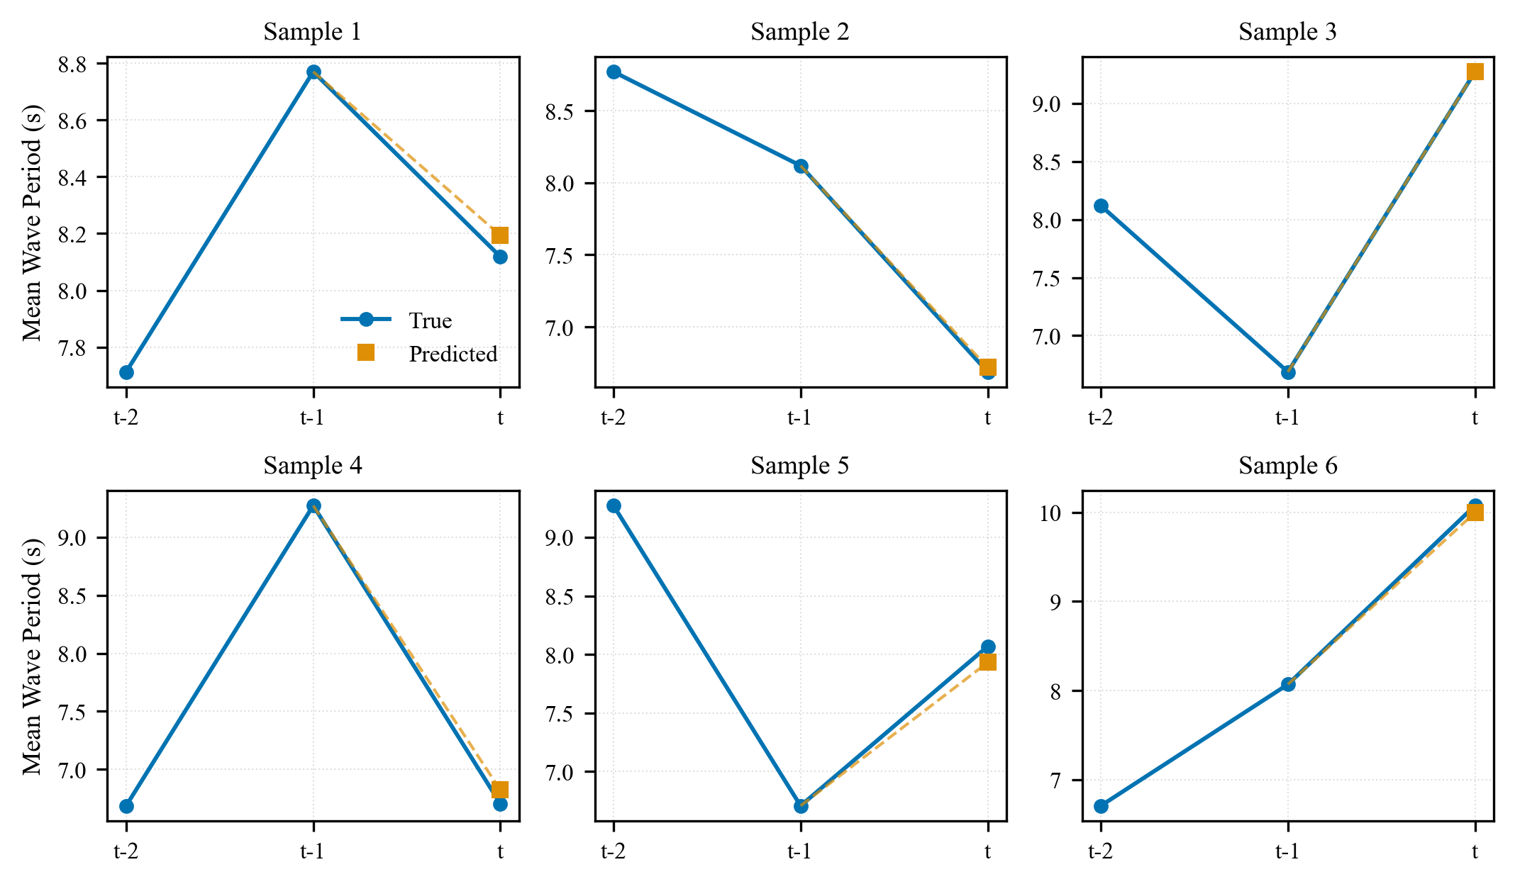
Results and Performance: mwp

Slide 23
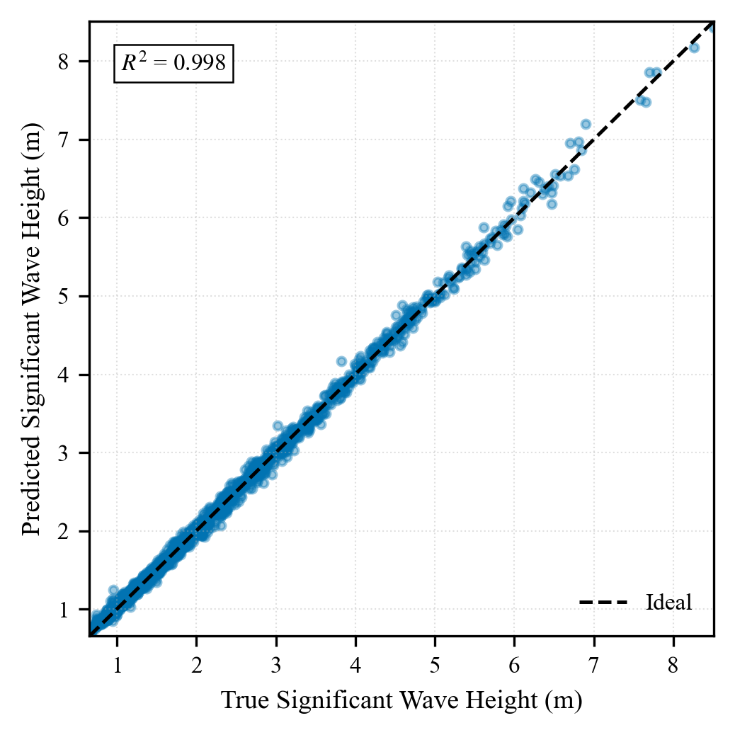
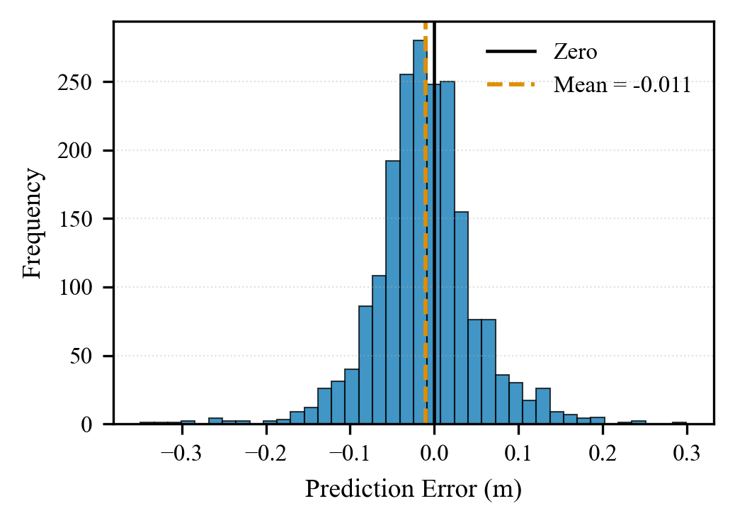
Results and Performance: swh

Slide 24
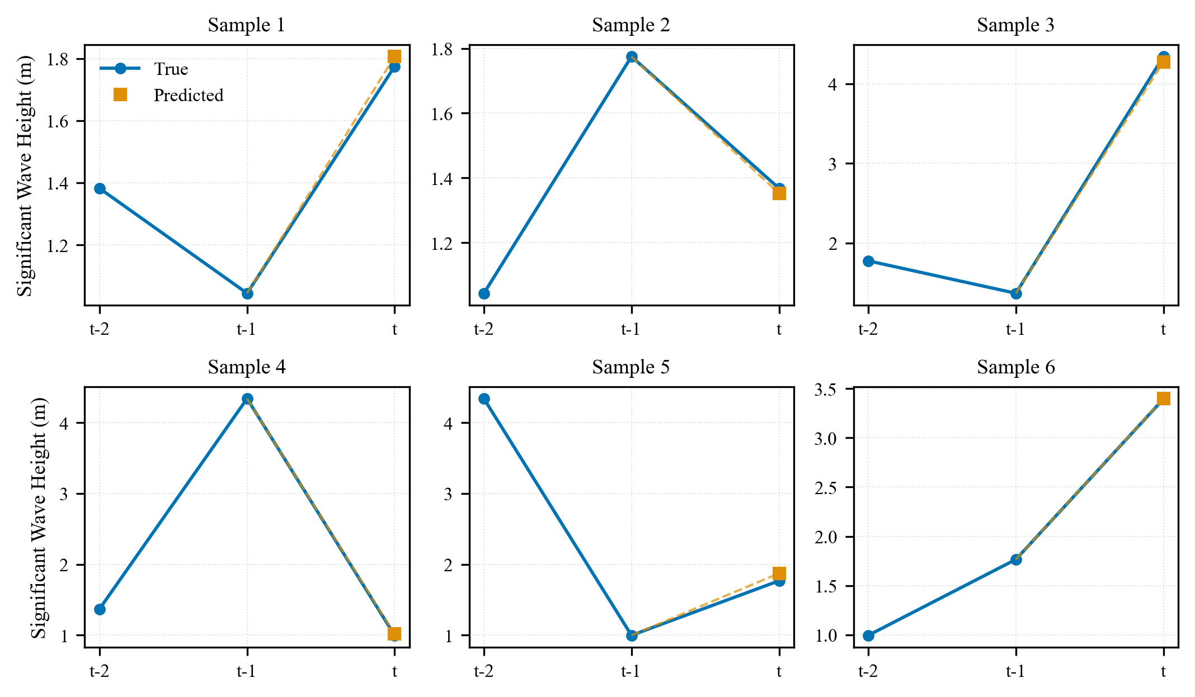
Results and Performance: swh

Slide 25
Results and Performance
Target | RMSE | MAE | R²
mwd | 2.5619 | 1.5574 | 0.9994
mwp | 0.0984 | 0.0743 | 0.9955
swh | 0.0613 | 0.0445 | 0.9977

Slide 26
Discussion: Overall Performance Assessment
The forecasting model demonstrated overall good performance for one-hour wave prediction.
Low MAE and RMSE values across all variables
Model successfully learned from two previous time steps
Effective one-hour-ahead forecasting capability
Compact autoencoder representation effectively preserved spatial and temporal dependencies while significantly reducing input dimensionality.
Performance
No need for supercomputing infrastructure
Validates autoencoder-MLP framework

Slide 27
Conclusions
Short-term wave forecasting in Azores region using data-driven approach is viable and effective.
Integration of autoencoder with MLP successful
108D → 32D compression effective
Accurate one-hour-ahead predictions achieved
Low normalized errors across all variables
Successfully captured while maintaining computational lightweightness

Slide 28
Next Steps
Analyze new available data, from sensor deployed and from simulations.
If needed run Simulations to get more data using Inductiva.
Built a data preprocessing pipeline from SWAN output to netCDF format.
Train ML model that surrogates SWAN simulations in Azores region.
Write a manual to train the network in other locations, giving the possibility to extend the capabilities of the model.

Slide 29
Thank you!
Bernardo Chagas, nº 103639

Slide 30
Images
https://www.ecmwf.int/en/about/media-centre/news/2015/course-probes-numerical-methods-weather-forecasting
https://www.newswire.ca/news-releases/ibm-makes-higher-quality-weather-forecasts-available-worldwide-857519446.html
https://commons.wikimedia.org/wiki/File:MultiLayerNeuralNetwork_english.png

